Slide 1
Object Oriented Programming
Classes and Objects

Slide 2
Topics
Class
Objects
Fields
Functions
Constructors : Default & Overloaded
Destructors
Static : Field & Methods

Slide 3
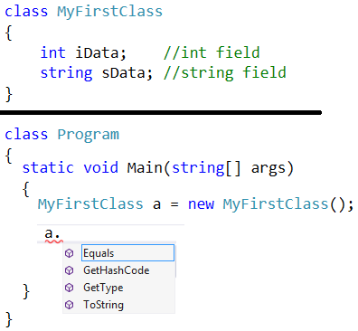
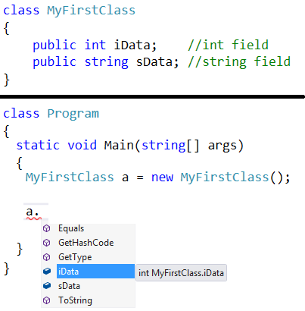
Class/Object & Encapsulation

Slide 4
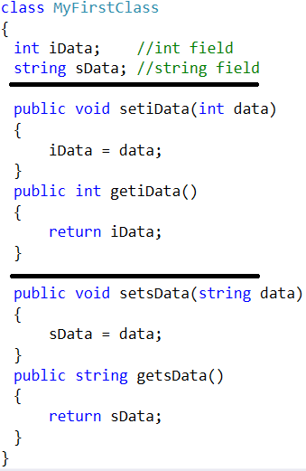
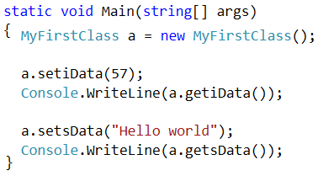
Encapsulation & Functions

Slide 5



Constructors : Default

Slide 6
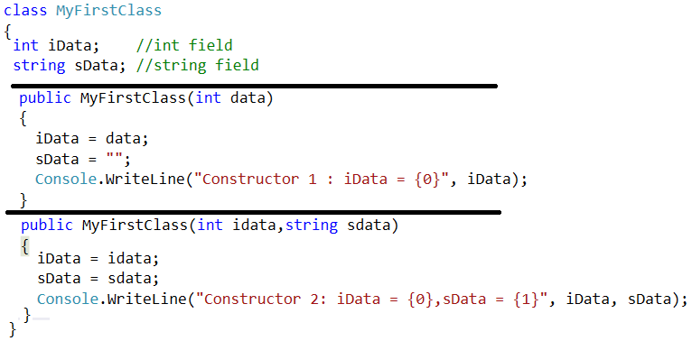

Constructors : Overloaded

Slide 7
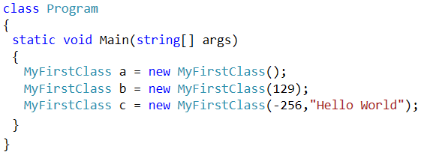

Constructors : Overloaded

Slide 8
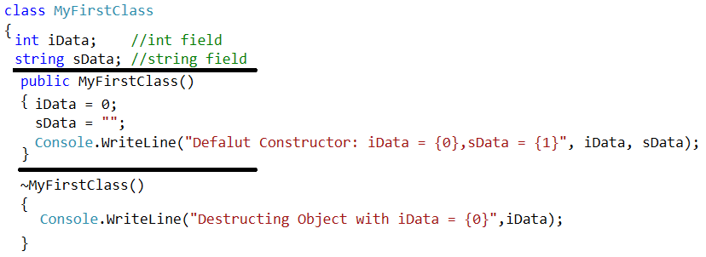
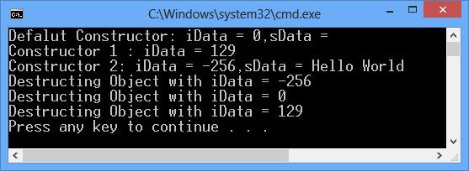
Destructors

Slide 9
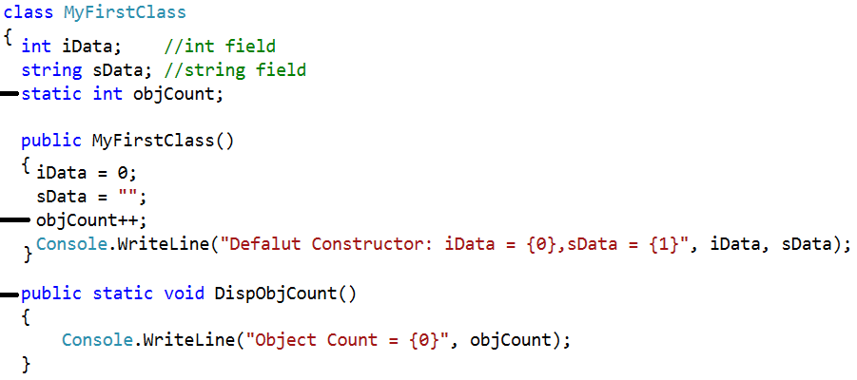
Static : Field & Function

Slide 10
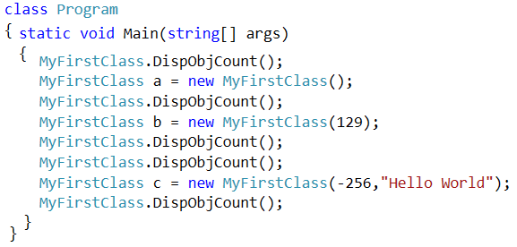
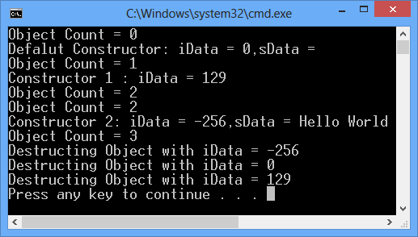
Static : Field & Function

